Slide 1
California Public Records Act (CAPRA)
How to utilize the CAPRA

Slide 2
What is the CAPRA?
The California Public Records Act requires that governmental records be accessible to the public when requested, unless exempt by the law.
Requests for identifiable, disclosable records must be responded to within timeframes and promptly available for anyone who pays duplication costs or statutory fees
If improperly withheld, the public may seek court order and may receive payment for court costs and attorney fees if they win the lawsuit

Slide 3
Defining CAPRA terms
LAYOUT 1
Public record - any writing with information related to the public’s business by any state or local agency
Writing - any handwriting, typewriting, printing, photostating, photographing, photocopying, transmitting by electronic mail or facsimile, and other means of recording
Requests do NOT need to state its purpose or use
Requesters do NOT have to justify or explain the reason for exercising their right of access

Slide 4
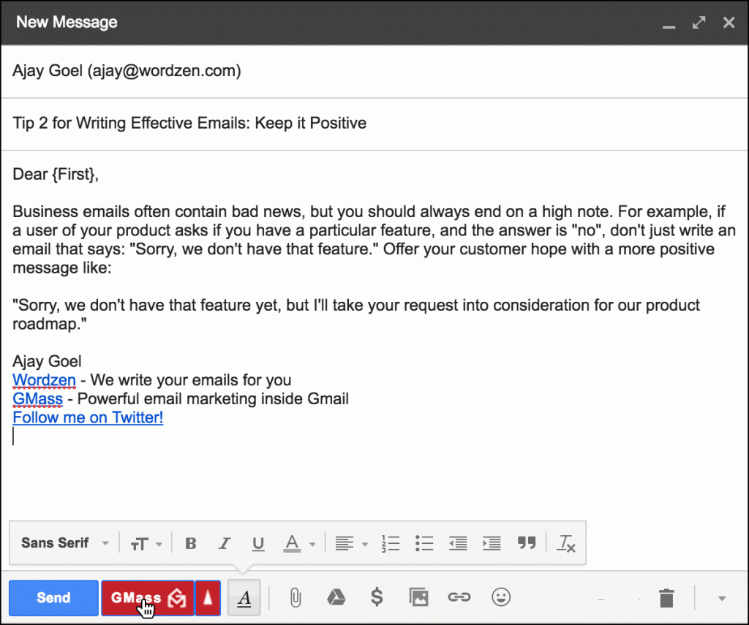
Examples what ARE public record
Generally:
Memos
Emails
Presentations
Bulletins
Data
Audio Recordings
Agendas
Proposals and contracts
More specifically:
Itemized statements of the total expenditures and disbursements of judicial agencies provides for under the State Constitution
Employment contracts between state and local agencies and any public official or employee

Slide 5
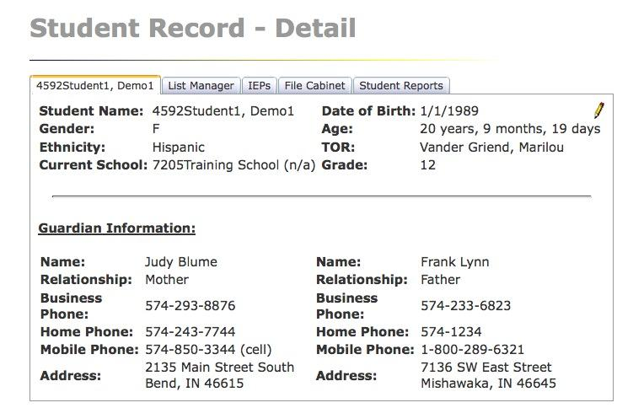
Examples of what is NOT public record
Personnel or medical records if disclosure unwarranted invasion of privacy
Preliminary notes, drafts, memoranda
Investigative records
Pending litigation or claims
Catch-all exemption
Attorney-client privileged communications & attorney work product
Student records

Slide 6
Who can request information?
LAYOUT 1
Any person or entity
Examples: media, for-profit businesses, and public entities
The right is not limited to:
Persons who are constituents outside of a district
A person who lives in a different city, county or state can access district records

Slide 7
Is every writing a public record?
NO, not all writings are public record for CPRA
Key element: if writing is kept because it is necessary or convenient to official duties
For example, a shopping list or letter from a friend that does NOT mention governmental activities are NOT public records

Slide 8
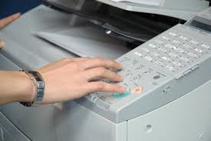
Types of Requests
The public can access public records by:
Requesting to inspect records
Receiving a copy of identifiable records
Manner of making requests:
In writing (paper or electronic)
Mailed, emailed, faxed, personally delivered, orally (in-person), or by phone

Slide 9
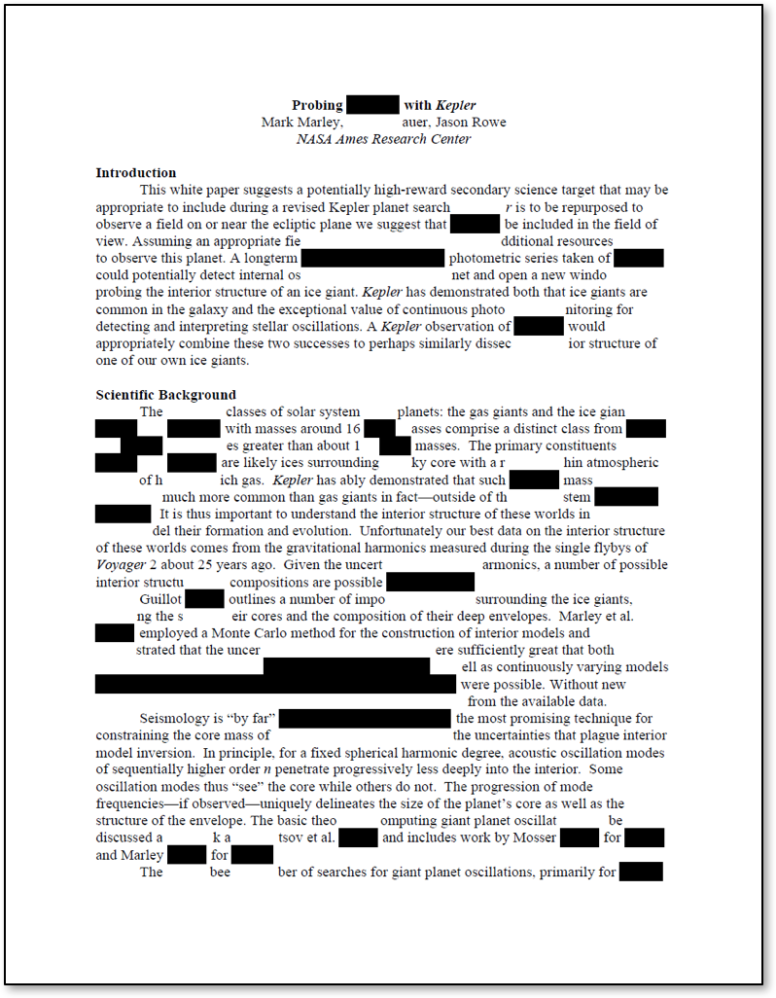
Content of Requests
Indicate public record is sought and focused enough to describe an existing, identifiable record
May describe writings by content and do not require identification of documents themselves
Agencies do NOT have a duty to comply with requests that seek records that do not exist

Slide 10
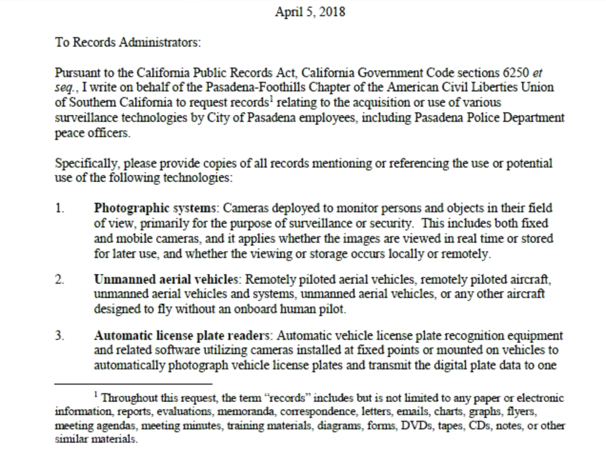
Letter format
“…relating to the acquisition or use of various surveillance technologies by City of Pasadena employees…”
Does NOT state purpose of the request

Slide 11
Response to Requests
Time periods to respond to requests:
Agency determines within 10 calendar days after the date of request receipt if records may be disclosed and promptly notify requester
Considered dates and time depend on the business hours of receipt and if it is a holiday or weekend
If there are identifiable public records, then determination must state the estimated time and date when records may be available

Slide 12
Response to Requests
In unusual circumstances, the time limit to initially reply may be extended by written notice.
It would say the reasons for the extension and the date which a determination is expected to be made
The extension CANNOT be more than 14 days
Unusual circumstances – need to search for records in separate offices, through voluminous amounts of records, consult with another agency with interest in the record, and compile date or create a computer program to extract the data

Slide 13
Time period for disclosing a record
Notifying a requester: initial 10-day response and 14-day extension time periods
The CPRA does NOT require that records actually be produced within these time periods
Records are made available “promptly” one determination has been made

Slide 14
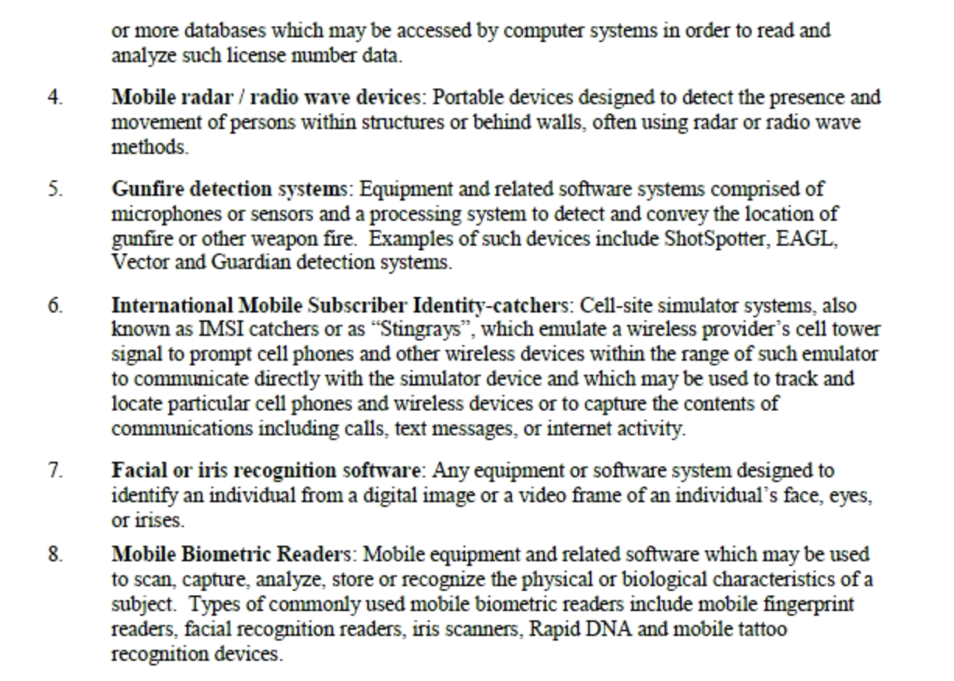
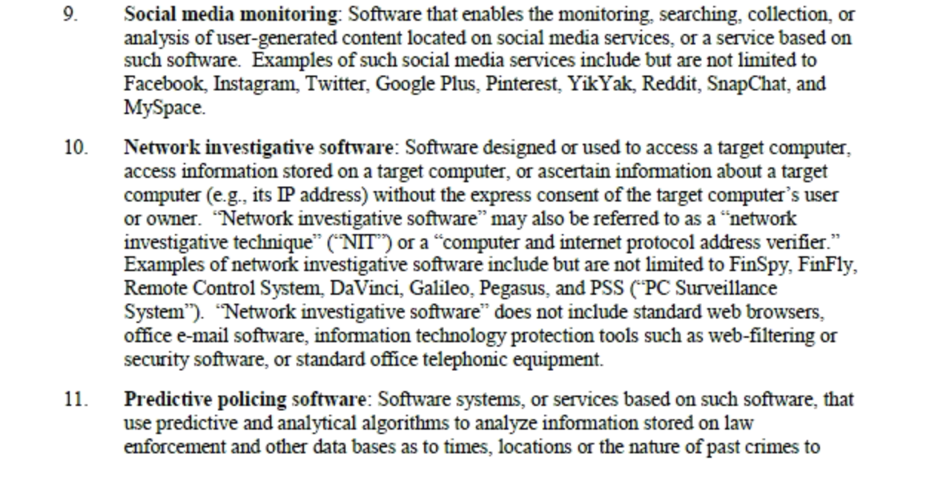
Requests specific mentions of use or potential use of forms of technologies

Slide 15
For more information:
Guide to CA Public Records Act
https://www.cacities.org/Resources/Open-Government/THE-PEOPLE%E2%80%99S-BUSINESS-A-Guide-to-the-California-Pu.aspx
Photo Copyright Flickr-Via Tsuji

Slide 16
WE THE PEOPLE

